Slide 1

Embedded Connectivity SS23
Prof. Dr. Ing. Andreas Grzemba
Ing. Johann Bretzendorfer
Group 1 Workstation 5 C1
Lakshmi Manasa Nambaru – 12202542
Vaishnavi Imandi - 22105113

Slide 2
Contents
Introduction
Overview of tools
Part-1: ANDi Tool and loopback
Part-2: ANDi Tool and Automotive Ethernet
Part-3: ANDi Tool and Automotive Ethernet in the Lab
Part-4: CAN over BroadRReach

Slide 3
Introduction:
This document presents a comprehensive report on the analysis and implementation of ANDI tool and loopback, Automotive Ethernet and Controller Area Network (CAN) over Broadreach R.
The project employed the use of the ANDi tool and Wireshark for data analysis and network monitoring.
This introduction provides an overview of the project's objectives, methodology, and the significance of exploring this novel approach to CAN communication.

Slide 4

Overview of Tools:
We have analyzed the python basic_loopback script using ANDi tool.
Ping is used for measuring the time takes for the packet to travel from the sender to the receiver and back.
ipconfig is a command line command included in Microsoft Windows, We determined IP and MAC address of our computer using ipconfig.
nmap is a free port scanner for scanning and evaluating hosts in a computer network. The name stands for Network Mapper.
We recorded the network traffic and handled all common ethernet protocols using Wireshark.

Slide 5
Part – 1: ANDi Tool and Loopback
After loading the “Demo.atp” file into ANDi script editor, the code is displayed on the editor and run the script.
The primary function of a script is to transmit a packet to the loopback adapter and subsequently receive the same packet from the loopback adapter, ensuring a seamless loopback process.
We used the Stimulation adapter for transmitting the signals, the Logging adapter for receiving the signals.

Slide 6
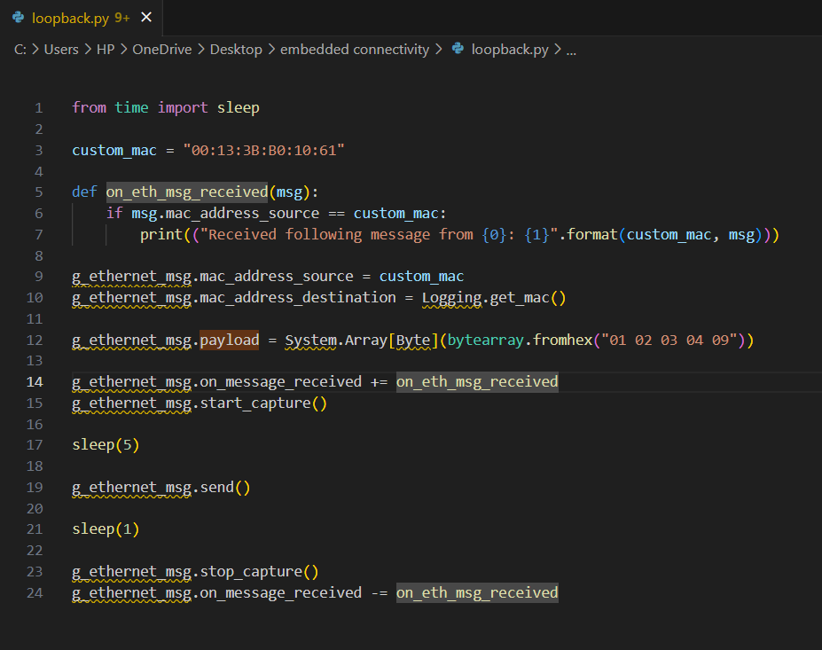
Basic Loopback script

Slide 7
To enhance the functionality of the basic loopback script, we created two new scripts.
The first script will be responsible for sending a frame, while the second script will handle receiving a frame.
we observed the source and destination MAC addresses, along with the transmitted and received payload data "01 02 03 04 09" using a loopback adapter using Wireshark.
Additionally, since the initialization of the script is triggered by a designated button, we will need to modify the sleep time values accordingly and updated scripts.

Slide 8
PART – 2: ANDi Tool and Automotive Ethernet
Our objective in this phase is to establish an actual point-to-point connection, treating the unconfigured media gateway as a Layer 2 switch.
Firstly, we started the ANDi tool and loaded the previous project done in task 1.
And then, update the ANDi adapter configuration with the appropriate network adapters, then we don’t use loopback anymore.
We used a “Simulation” adapter for transmitting in PC1 and a “Logging” adapter for receiving in PC2.
And from the scripts we have adjusted the MAC addresses.

Slide 9
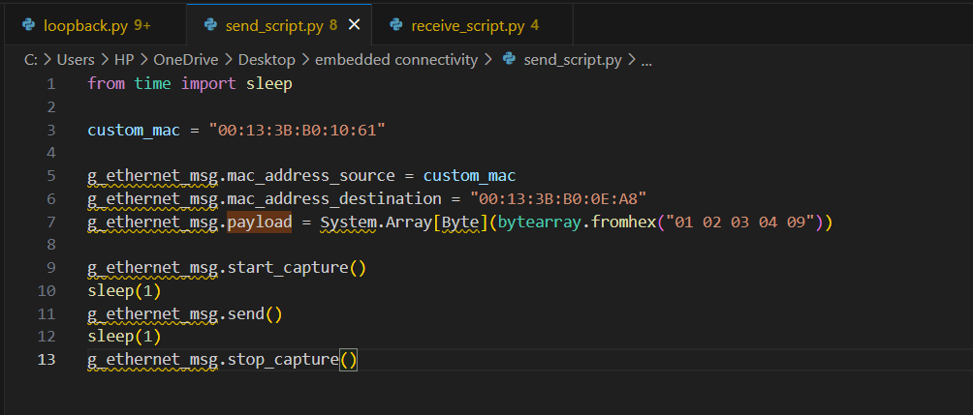
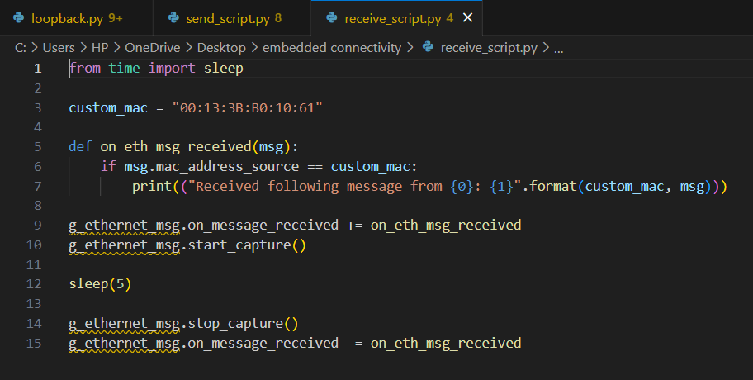
Send Receive Scripts

Slide 10
Before establishing the network connections, it is necessary to configure the media gateway accordingly.
We have to activate the VLAN feature of Media Gateway by prepare the internal ports for VLAN by assigning them a unique VLAN number.
Establish a VLAN connection between the two computers by configuring the media gateway ports accordingly.
Validate the functionality by utilizing your transmit and receive scripts.
Use Wireshark to verify the traffic between the computers.

Slide 11
Task3- ANDi Tool and Automotive Ethernet in the Lab
•In this task we used Media Gateway which is testing and network analysis tool for on-board vehicles developed by Technica Engineering
•Main goal of this task was to establish VLAN connection using Media Gateway which helped us to understand interface working of Media Gateway.
•During this task we have connected computers to local webcam. We configured following ports S3-P8, S3-P4, S2-P8, S2-P4 and S1-P8 as a member of VLAN 73 in order to gain access to local webcam.
we have to configure the ports of Media Gateway in such a way that both PCs establish the following connections:
1. PC 1 – Central Webcam – Media Gateway Configuration
2. PC 2 – Central Webcam – Local Webcam.

Slide 12
Connection of MediaGateway
For establishing physical connection with the central media gateway, we have to set S2-P3 port in Master mode, because the default value of counterpart in central Media gateway is slave.
In Wireshark, if we analyse the traffic, we can see that MAC based communication being performed between PC1 and PC2. By checking source or destination, we can realize that the communication is taking place via VLAN and is based on the configuration that we did earlier.

Slide 13
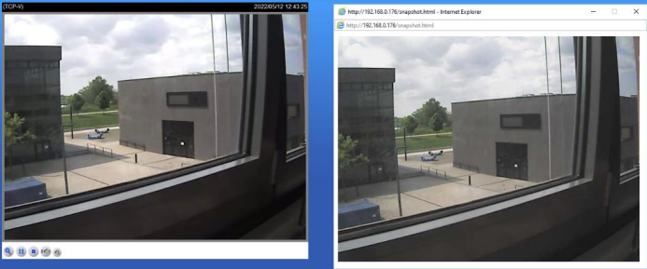
WEB CAM Output

Slide 14
Task4- CAN over BroadRReach
Monitoring and remaining bus simulation with ANDi tool on a CAN structure via a BroadRReach line.
The motor can be controlled by 3 ways:
1. Manually controlling the speed and direction of the motor with the push buttons on the microcontroller.
2. Controlling the motor by CANoe panel.
3. Controlling the motor by media gateway by directly giving the speed and direction in numerical

Slide 15
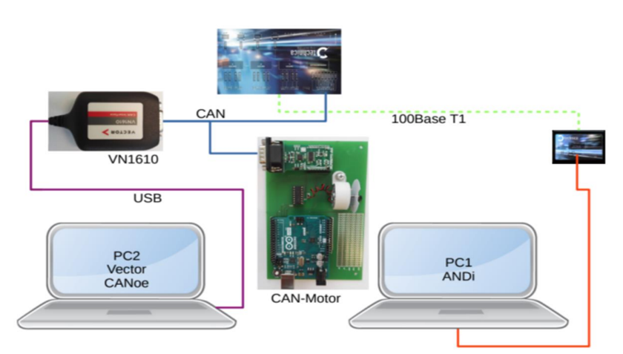
Setup
The structure of the workstation remains unchanged in principle. Only the CAN part is added, the CAN bus is connected to CAN A at the MediaGateway and the CANcaseXL is connected to computer 2 via USB. a Restbus simulation with CANoe is executed on computer 2.

Slide 16
CAN
•CAN bus: It is a message based protocol designed to allow microcontrollers and devices to communicate with each other's applications without a host computer.
• ID Allocation: Message IDs must be unique on a single CAN bus. In our project the main messages Ids are:
Ø0x101: MotorControl
Ø0x102: MotorStatus
• Frames: the standard or base frame format(11 bit) or extended frames(29 bit).
In our project, we are using 11 bits for the identifiers

Slide 17
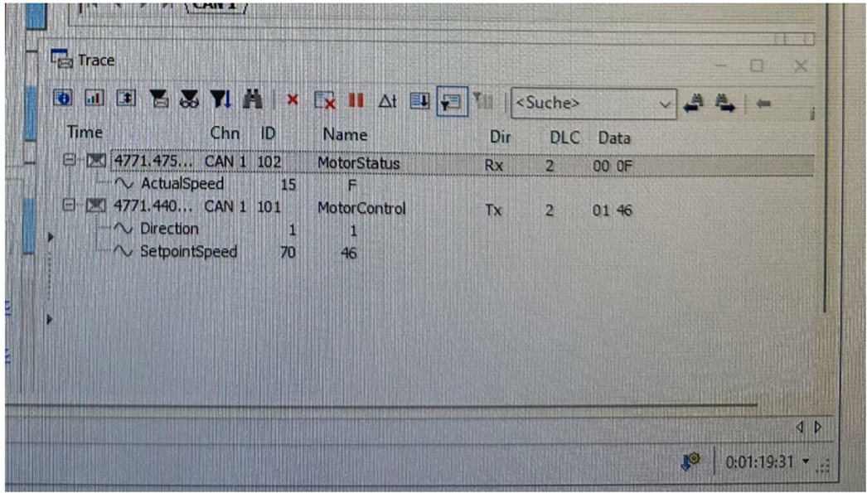
CANoe tool – CAN Trace

Slide 18
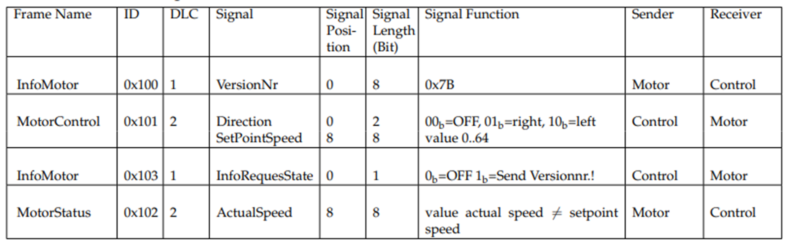
CAN Frames and Signals:

Slide 19
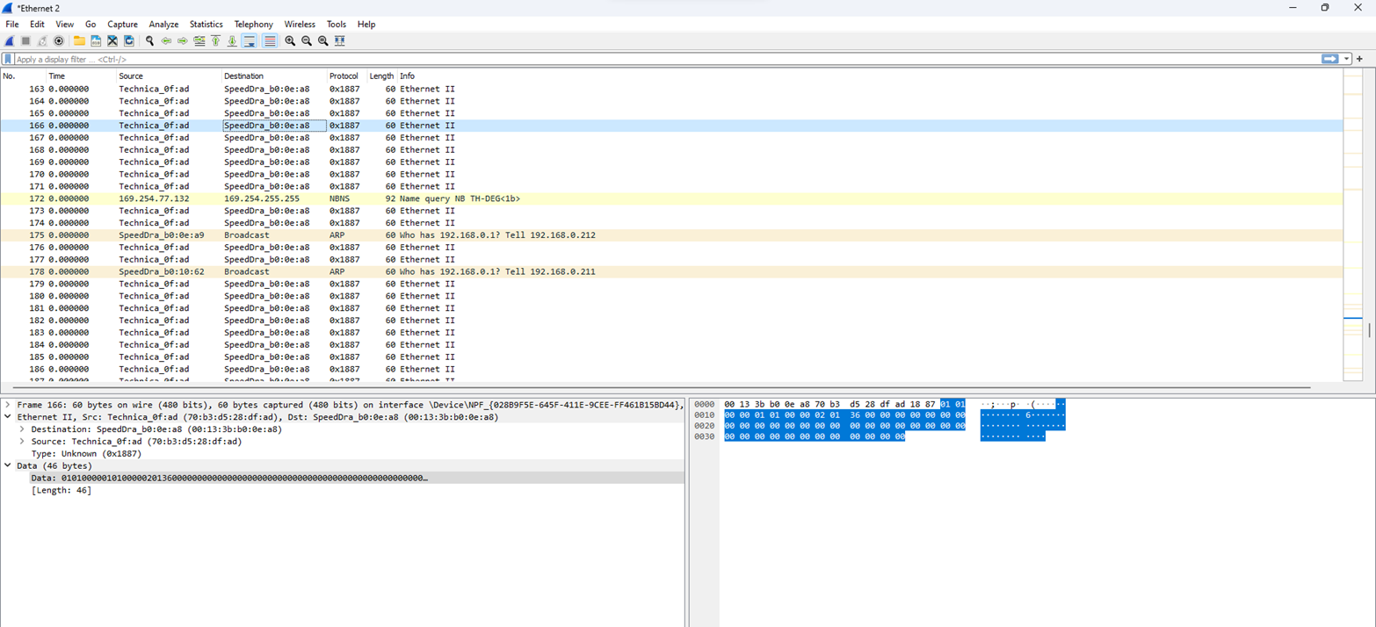

Slide 20
MediaGateway and ANDi Configuration
The MediaGateway serves as a bridge between the computer system and various media devices, enabling seamless communication and access to multimedia content. ANDi, on the other hand, is a powerful backend development tool that simplifies API creation and facilitates data management.
•The remaining bus simulation by the CANoe and CANCaseXL should then be stopped and replaced by the ”ANDi Traffic Generator”.
•This means that ANDi on PC1 transmits CAN frames encapsulated in UDP or RAW via the BroadRReach line to the CAN bus.

Slide 21
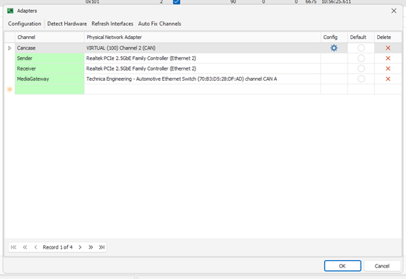
ANDi Network Settings

Slide 22
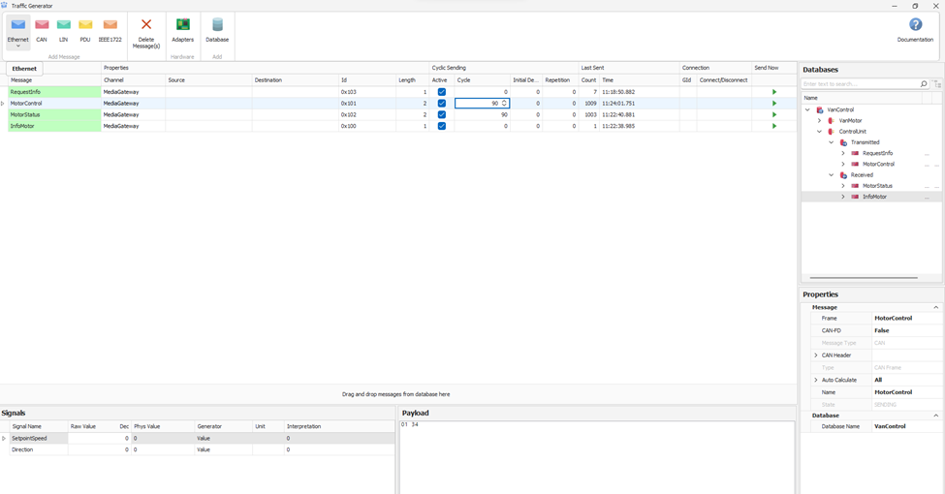
Send Messages in ANDi

Slide 23
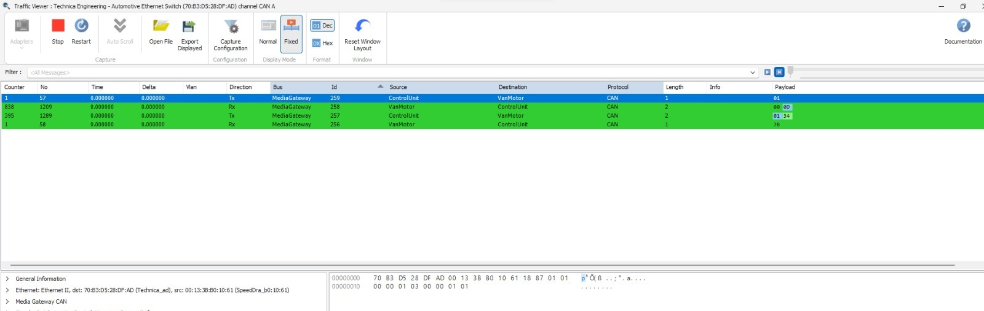
Messages in ANDi Traffic Viewer

Slide 24

We are very Grateful to the Professor and University for providing us the opportunity to learn Embedded concepts which helps us in choosing the desired career.

